Slide 1
Management 515
Managers and Managing
© 2014, 2015 David E. Frick.
All rights reserved.

Slide 2
What is Management
Management. The planning, organizing, leading, and controlling of human and other resources to achieve group goals effectively and efficiently. Management does not exist in nature. Packs of animals have pack leaders (usually the biggest and strongest member), not pack managers
Organizations. Collections of people who work together and coordinate their actions to achieve a wide variety of goals or desired future outcomes.
Managers. The people responsible for supervising the use of an organization’s resources to meet its goals. All managers work in organizations
Notes:
Here are some definitions for this lecture.
Management is not leadership. In my view of the world, manager and leader are two distinct roles. They are related, but distinct. Each has different characteristics.

Slide 3
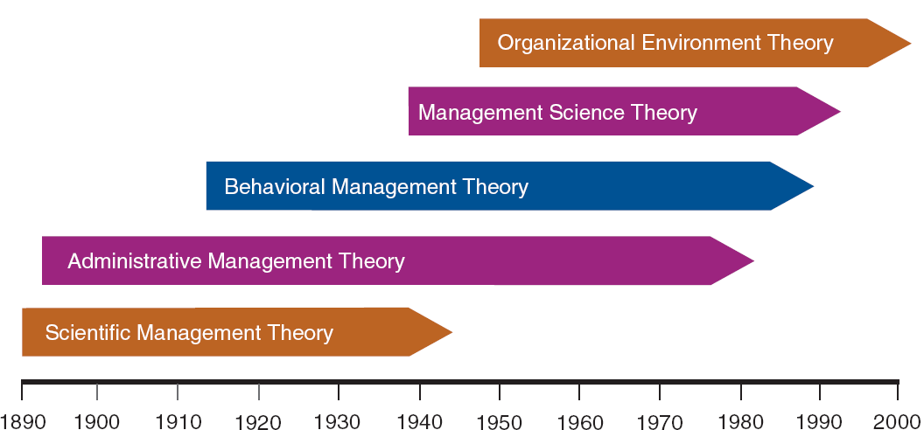
Management is an Invention of Man
Adapted from Contemporary Management, 8th, G.R. Jones & J.M. George
Notes:
Management is an invention of man. As we, transitioned from an agrarian society to an industrial one, it became apparent that they way people interacted to accomplish tasks had distinct patters. Theories of management, starting with Scientific Management Theory, was crafted to explain these interactions.

Slide 4
Principles
Division of labor. The best way to apply labor
Authority. Managers must be able to give orders. Keep in mind that responsibility arises wherever authority is used
Discipline. Employees must obey and respect the rules of the organization
Unity of command. Every employee should receive orders from only one superior
Unity of direction. Like organizational activities should be directed by one manager using one plan
Notes:
All of these theories have common characteristics or principles.

Slide 5
Principles
Subordination. The interests of employees should not take precedence over the interests of the organization
Remuneration. Employees must be paid a fair wage
Centralization. Refers to the degree to which subordinates are involved in decision making
Scalar chain. The line of authority from top management to the lowest ranks. Communications should follow this chain
Order. The systematic arrangement of men, machine, and material. One place for every resource and employee

Slide 6
Principles
Equity. Managers should be kind and fair
Stability of personnel. High employee turnover is inefficient
Initiative. Invested employees (who are allowed to originate and carry out plans) will exert high levels of effort
Esprit-de-corps. Promoting team spirit builds harmony and unity within the organization

Slide 7
Four Tasks of Management
Planning. Choosing appropriate organizational goals and strategies to best achieve those goals
Organizing. Establishing tasks and relationships that allow members of the organization to achieve organizational goals
Controlling. Establishing accurate methods to measure performance, monitoring that performance, and making adjustments needed to stay within established norms
Leading. Inspiring members of the organization to work to achieve organizational goals
Notes:
Most believe that management has four distinct tasks. This four task model includes leadership as one of the tasks. I tend to consider leadership as a separate role. One can manage without leading, and conversely lead without managing. However, I do not believe it is vital to reject this model.

Slide 8
Six Tasks of Management
Henri Fayol (1841–1925) (Fayolism or Scientific Management) defines management as consisting of six functions:
Forecasting
Planning
Organizing
Commanding
Coordinating
Controlling
Planning
Organizing
Controlling
Leading
Notes:
Henri Fayol’s model used six tasks. I think these really fold into the previous four.
Although scientific management as a distinct theory or school of thought was obsolete by the 1930s, most of its themes are still important parts of Industrial engineering and management today.
Taylor's four principles include:
Replace working by "rule of thumb," or simple habit and common sense, and instead use the scientific method to study work and determine the most efficient way to perform specific tasks.
Rather than simply assign workers to just any job, match workers to their jobs based on capability and motivation, and train them to work at maximum efficiency.
Monitor worker performance, and provide instructions and supervision to ensure that they're using the most efficient ways of working.
Allocate the work between managers and workers so that the managers spend their time planning and training, allowing the workers to perform their tasks efficiently.

Slide 9
1. Planning
The responsibility of senior management of each level within the organization
Corporate
Function or division
Office
Planning can be strategic (long-term) or tactical (short-term). Short-term plans must be consistent with strategy
Planning must not be static (collecting dust on the shelf)
“Plans are nothing; planning is everything.”
Notes:
The process of planning forces management to think about aspects of the organization or environment to expose opportunities and threats
“Plans are nothing; planning is everything.” --Dwight D. Eisenhower
What President Eisenhower meant by this was that once a plan is finished, it probably is already outdated. What is important is the concept of planning. If leaders and managers are constantly planning (or thinking about planning), then the chances of surprise are reduced.

Slide 10
2. Organizing
Organizing. Establishing tasks and relationships that allow members of the organization to achieve organizational goals
Responsibilities
Lines of authority
Resource allocation
Organizational structure. A formal system of task and reporting relationships that coordinates organizational activities so that members can work together to achieve organizational goals
Types. Functional, Divisional, Matrix, Project
Hierarchy
Notes:
Organizational structure will be addressed in a future lecture.

Slide 11
3. Controlling
The outcome of the control process is the ability to measure performance accurately and regulate organizational efficiency and effectiveness
Managers must decide which goals to measure
Outcomes are a better measure than outputs
Outcome are often hard to define
Outputs are better than transactions
Measuring transactions is only useful when transactions can be linked to outcomes, e.g., a strong, positive correlation between Web site hits and revenue
Measuring is the essence of management

Slide 12
Organizational Performance
Organizational Performance. A measure of how efficiently and effectively managers use available resources to satisfy customers and achieve organizational goals
Efficiency. How well or how productively resources are used to achieve a goal. “Doing things right”
Effectiveness. Appropriateness of the goals an organization is pursuing. “Doing the right things”
Resources. Include people, with their knowledge, skills, and abilities (KSAs), organizational know-how and experience, machinery, raw materials, equipment, patents, and financial capital

Slide 13
4. Leadership
The application of power, personality, influence, persuasion, and communication skills to inspire others to achieve one or more goals.
The influential increment over and above mechanical compliance with the routine directive of the organization
Exercised power when persons mobilize institutional, political, psychological, and other resources so as to arouse, engage, and satisfy the motives of followers
Realized in the process whereby one or more individuals succeed in attempting to frame and define the reality of others

Slide 14
How Do Leaders Inspire?
Articulating visions, embodying values, and creating the environment within which things can be accomplished
Giving purpose to collective effort and causing willing effort to be expended to achieve purpose
Making sense of what people are doing together so that people will understand and be committed
Stepping outside of the culture…to effect change
Notes:
In my view, the role of the leader is to inspire people to do things they would not otherwise do, left to their own devices.
In my view leaders do not motivate. You may ask, “what is the difference between motivating and inspiring?” A fair question. My answer is that I like to view motivation as an internal physiological response to stimuli. Inspiration is generally a logical argument. Inspiration can have an emotional component, but I argue that the emotion is rooted in a core belief that already exists.

Slide 15
Managers Versus Leaders
Topic | Manager | Leader
1. Essence | Establish | Change
2. Rules | Make | Break
3. Approach | Planning Details | Sets Direction
4. Culture | Execute | Shape
5. Conflict | Avoid | Use
6. Direction | Existing Road | New Road
7. Credit | Take | Give
8. Decisions | Make | Facilitate
9. Vision | Tell | Sell
10. Style | Transactional | Transformational
Notes:
View this video: https://www.youtube.com/watch?v=8ubRzzirRKs

Slide 16
Leader Role versus Manager Role
Manages work
Manages subordinates
Achieves results
Risk averse
Involved
Relies on position and authority
Effects change
Leads followers
Risk-taking
Facilitative
Relies on charisma and influence
Dictatorial
Authoritative
Transactional
Autocratic
Consultative
Democratic
Transformational
Consultative
Participative
Leader
Manager
Notes:
I argue that pure managers and pure leaders do not exist in the real world.
All managers must lead from time to time and all leaders must manage once in a while. As leaders and mangers move left and right on this continuum, the mix of these tasks varies.

Slide 17
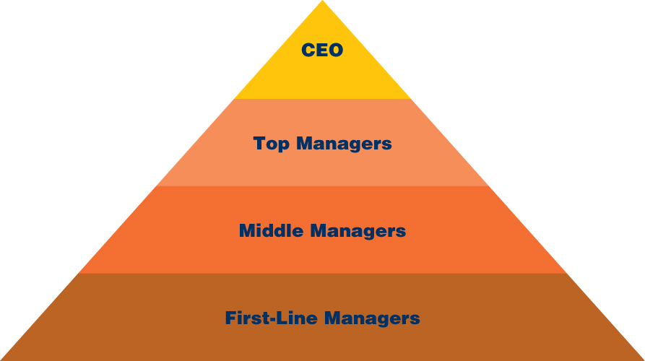
Levels of Management
Notes:
Here is a classic model of the levels of management.
The CEO is the one person responsible for the entire organization.
Top managers include the most senior management, e.g., vice presidents, directors. This senior managers typically oversee a single function.
Middle managers or second-line supervisors are two levels removed from the workers.

Slide 18
What Can Managers Influence?
The interpretation of external events by members
The choice of objectives and strategies to pursue
The motivation of members to achieve the objectives
The mutual trust and cooperation of members
The organization and coordination of work activities
The allocation and resources to activities and objectives
The development of member skills and confidence
The learning and sharing of new knowledge by members
The enlistment of support and cooperation from outsiders
The design of formal structure, programs, and systems
The shared beliefs and values of members
Adapter from Leadership in Organizations, Yukl
Notes:
Managers cannot influence everything. However, Yuki suggest these are eleven things they can.
The four that I have identified are, in my opinion, are the areas where managers have the least influence. These are items of culture. It is easy to assign a worker to a job, but hard to make certain the worker likes the decision.

